Slide 1
LSM-based Storage Techniques: A Survey
Chen Luo, Michael J. Carey
VLDB Journal, 2019
2021. 08. 30
Presentation by Shin, Hojin
hojin03s@dankook.ac.kr

Slide 2
LSM-Tree Basics
LSM-Tree Improvements
Conclusion

Slide 3
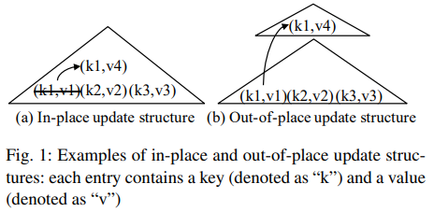
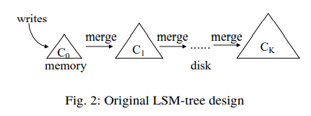
1. LSM-Tree Basics
LSM-Tree Features
Cost analysis of writes, reads, and space utilization of LSM-Tree
Not out-of-place update, use in-place update structure
Out-of-place update = Incur Random I/Os
In-place update = Sequential I/Os
Memory buffer and flush, merge operation

Slide 4
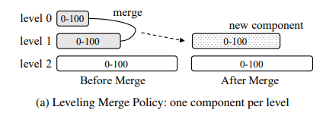
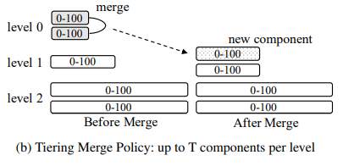
1. LSM-Tree Basics
LSM-Tree Merge Policies (Not partitioning)
Leveling Merge Policy: one component per level
Component at level L is T times larger than the component at level L-1
Tiering Merge Policy: up to T components per level
If level L is already the configured maximum level, then the resulting component remains at Level L
T = size ratio
Component = run / Merge = compaction

Slide 5
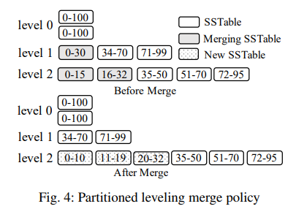
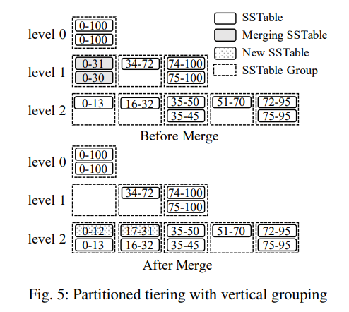
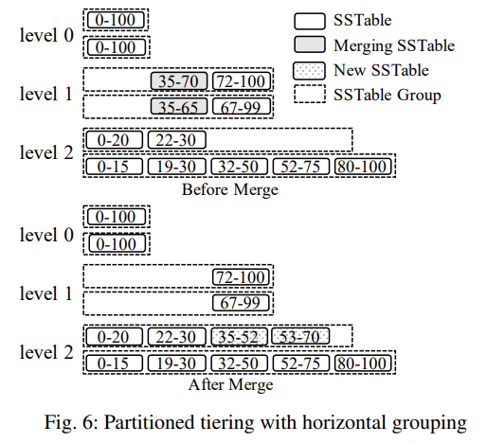
1. LSM-Tree Basics
LSM-Tree Merge Policies (Partitioning)
Partitioning Leveling Merge Policy
Range partitioned into multiple fixed-size SSTables
Partitioning Tiering Merge Policy
Vertical Grouping
Groups SSTable with overlapping key ranges together
Horizontal Grouping
Groups SSTable with not overlapping key ranges together
Set of fixed-size SSTables

Slide 6
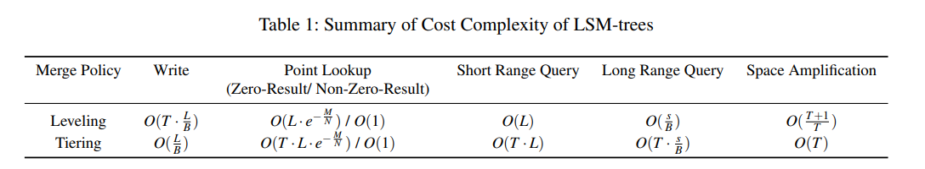
1. LSM-Tree Basics
Cost Analysis
T = Size ratio of a given LSM-tree
L = Number of levels
B = Page size, the number of entries
P = Number of pages of a memory component
N = Total entries / M = Bloom filter bits / s = the number of unique keys accessed by a range query

Slide 7
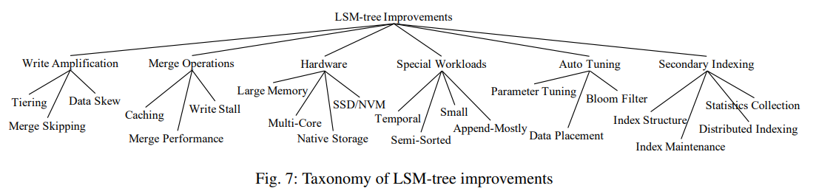
2. LSM-Tree Improvements
Taxonomy of LSM-Tree Improvements
Write Amplification : limits the write performance, reduces lifespan of SSDs
Merge Operations : buffer cache misses, write stall
Hardware : large memory, multi-core, SSD/NVM, native storage
Special Workloads
Auto-Tuning : read, write, space-optimal
Secondary Indexing

Slide 8
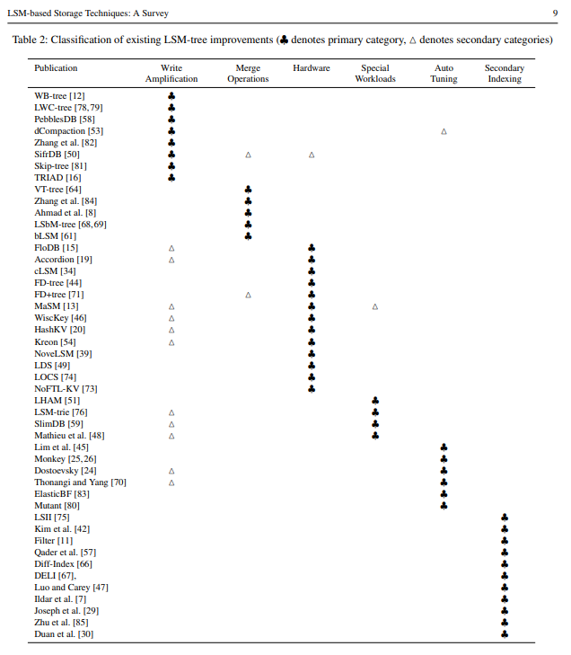
2. LSM-Tree Improvements

Slide 9
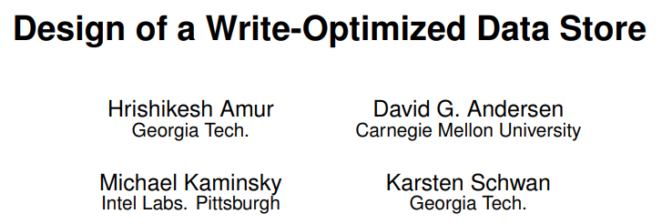


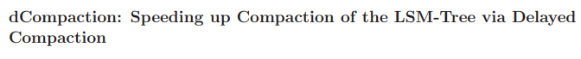
2. LSM-Tree Improvements
Reducing Write Amplification (Tiering)
WrtieBuffer(WB) Tree
Partitioned tiering design with vertical grouping
SSTable group into a B+-tree-like structure
Light-weight compaction tree (LWC-Tree)
Partitioned tiering design with vertical grouping
SSTables are no longer strictly fixed-size
PebblesDB
Using the idea of guards that are selected probabilistically based on inserted keys
Applied lazily during the next merge
dCompaction
Virtual merges to reduce the merge frequency
Threshold based on the number of real SSTables to trigger actual merges
Mainly differ in how workload balancing of SSTable groups is performed

Slide 10
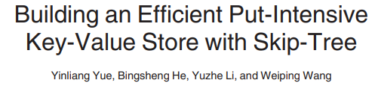
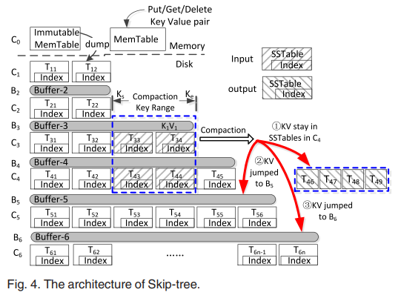
2. LSM-Tree Improvements
Reducing Write Amplification (Merge Skipping)
Skip Tree
Merge Skipping idea
Each entry must be merged from level0 down to the largest level
Some keys to a mutable buffer at level L+K
To reduce logging overhead, the skip tree only log the key plus the ID of the original SSTable and prevents an SSTable from being deleted if it is referenced by any key in the buffer

Slide 11
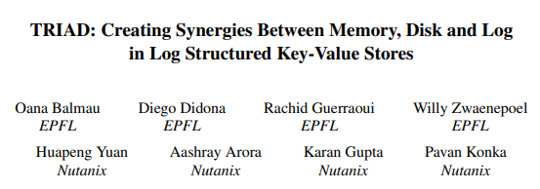
2. LSM-Tree Improvements
Reducing Write Amplification (Data Skew)
TRIAD
Reduce WAF for skewed update workloads where some hot keys are update frequently
Only cold keys are flushed to disk
When hot keys are updated, old versions can be discard directly without writing them to disk
Delaying merges at level 0 until level 0 contains multiple SSTables
Avoids creating new disk components
But, range query performance worse, entries are not sorted in the log

Slide 12
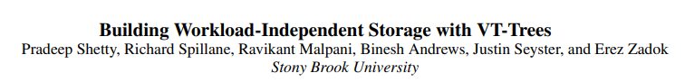
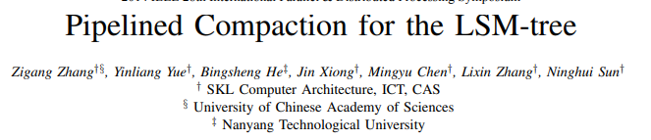
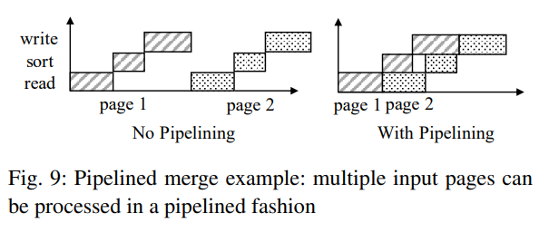
2. LSM-Tree Improvements
Optimizing Merge Operations (Improving Merge Performance)
VT-Tree
Use KVFS (use FUSE)
Stitching operation – improves performance for certain workloads
Drawbacks = Fragmentation, keys in stitched pages are not scanned during a merge operation
Pipelined Compaction
Merge operation = Read, Merge-Sort, Write phases
Read, write ➔ I/O heavy / Merge-sort ➔ CPU heavy
Better utilize CPU and I/O parallelism

Slide 13

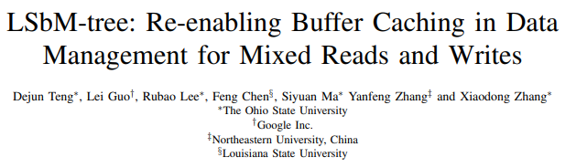
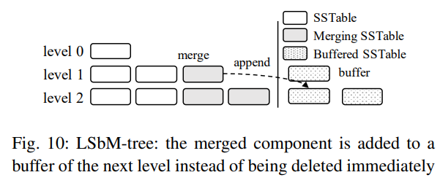
2. LSM-Tree Improvements
Optimizing Merge Operations (Reducing Buffer Cache Misses)
Compaction Management
Smart cache warmup algorithm
Fetch the new component incrementally to minimize buffer cache misses
Insufficient due to contention between the newly produced pages and the existing hot pages
LSbM-Tree

Slide 14
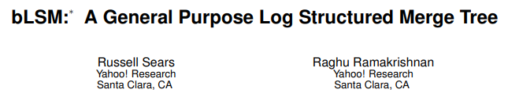
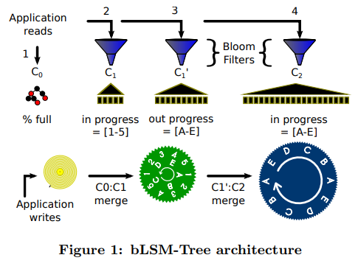
2. LSM-Tree Improvements
Optimizing Merge Operations (Minimizing Write Stalls)
bLSM
Spring and gear merge scheduler (unpartitioned leveling merge policy)

Slide 15
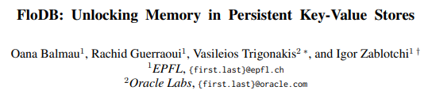

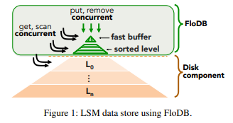
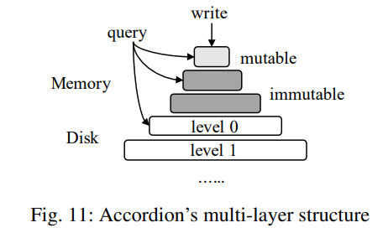
2. LSM-Tree Improvements
Hardware Opportunities (Large Memory)
FloDB
Two-layer design to manage large memory component
Top level: small concurrent hash table to support fast writes
Bottom level: large skip-list to support range queries efficiently
Accordion
Multi-layer approach to manage tis large memory component
Mutable memory full ➔ Immutable memory

Slide 16

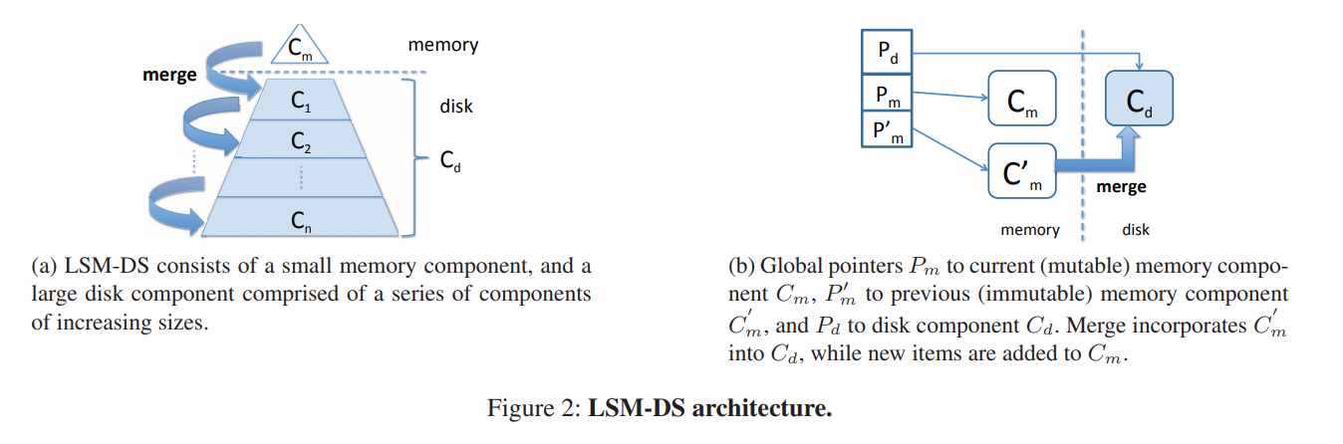
2. LSM-Tree Improvements
Hardware Opportunities (Multi-Core)
cLSM
Optimizes for multi-core machines
LSM component into a concurrent linked list to minimize blocking

Slide 17
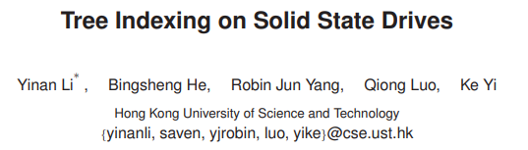


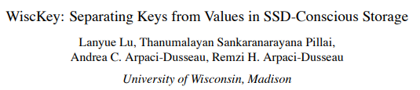
2. LSM-Tree Improvements
Hardware Opportunities (SSD/NVM)
FD-Tree
Fractional cascading to improve query performance instead of BF
Each level, additionally stores fence pointers
After merge, rebuild the fence pointers
FD+Tree
Improves the merge process of the FD-Tree
Incrementally activates the new components and reclaims pages from the old components that are not used by any active queries
MaSM
Supporting efficient updates for data warehousing workloads
First buffers all updates into an SSD
Targets long range queries
Wisckey
Separate Key and Value
Append only log and maps each key to its location in the log
Reduce write cost by only merging keys

Slide 18
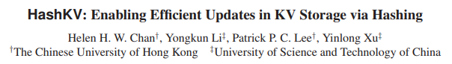

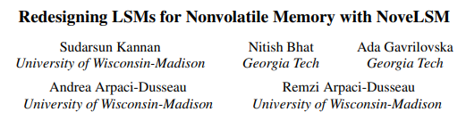
2. LSM-Tree Improvements
Hardware Opportunities (SSD/NVM) cont’
HashKV
Efficient approach to GC obsolete values
Hash-partition the value log into multiple partitions based on keys and to GC each partition independently
Stores cold entries separately
Kreon
Reduce CPU overhead by avoiding unnecessary data copying
Customized memory-mapped I/O manager
NoveLSM
Implementation of LSM-trees on NVMs
Adds an NVM-based memory component to serve writes
Skipping logging

Slide 19
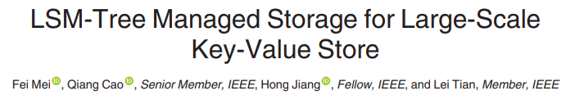
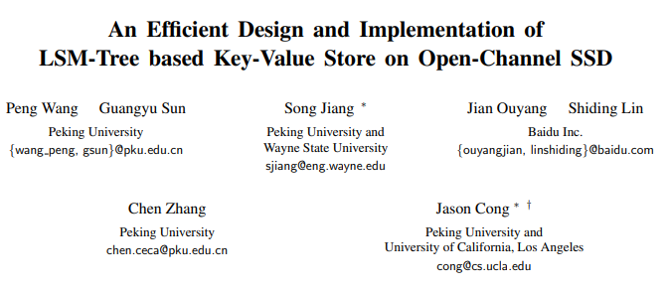
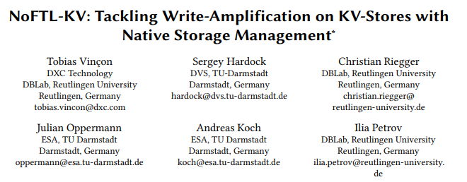
2. LSM-Tree Improvements
Hardware Opportunities (Native Storage)
LSM-tree-based Direct Storage system (LDS)
Bypasses the file system to better exploit the sequential and aggregated I/O patterns exhibited by LSM-trees
Three parts: chunks, version log, backup log
Chunks: disk components / Version log: metadata / Backup log: WAL
LOCS
Implementation of the LSM-tree on OCSSD
Internal I/O parallelism via an interface called channel
Places SSTables from different levels with similar key ranges into different channels
NoFTL-KV
Extract the flash translation layer
Pushing tasks down to the storage device
Performing more efficient data placement to exploit I/O parallelism
Integrating GC process of the storage device with the merge process

Slide 20
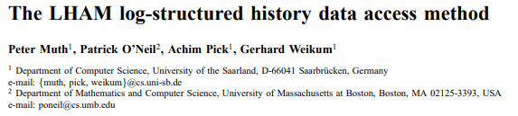
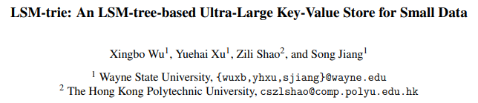
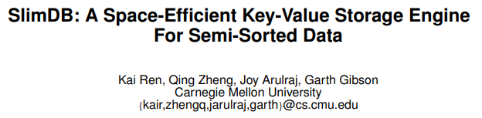
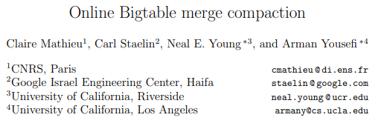
2. LSM-Tree Improvements
Handling Special Workloads
The log-structured history access method (LHAM)
Efficiently support temporal workloads
Attach a range of timestamps to each component to facilitate the processing of temporal queries
LSM-trie
Hash-index for managing a large number of key-value pairs where each key-value pairs is small
Using the prefix of their hash values to reduce the metadata overhead
Build BF for each bucket
SlimDB
Targets semi-sorted data in which each key contains a prefix x and suffix y
Hybrid structure with tiering on the lower levels and leveling on the higher levels
Bigtable merge compaction
Optimized for append-mostly workloads with a bounded number of components
Two merge policies: MinLatency and Binomial

Slide 21
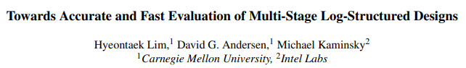
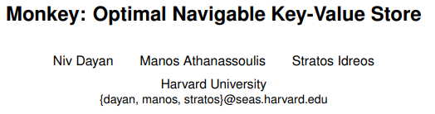
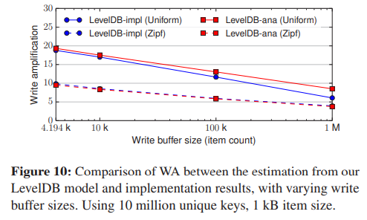
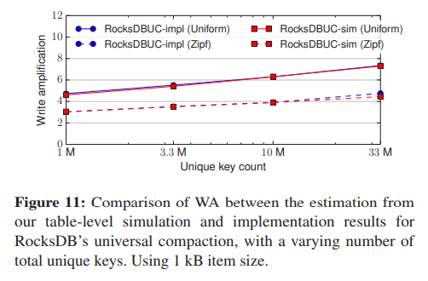
2. LSM-Tree Improvements
Auto-Tuning (Parameter Tuning)
Lim et al
Analytical model that incorporates the key distribution to improve the cost estimation of LSM-tree operations and further used this model to tune the parameters
Monkey
Co-tunes the merge policy, size ratio, and memory allocation between memory components and BF

Slide 22
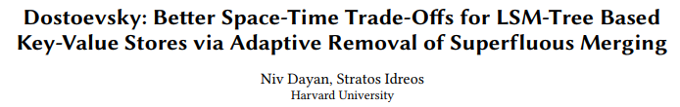
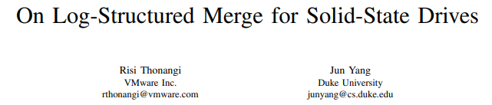
2. LSM-Tree Improvements
Auto-Tunning (Tuning Merge Policies)
Dostoevsky
Lazy-leveling merge policy: tiering at lower level, leveling at the largest level
Largest level: at most Z components / Each of smaller level: at most K components
Z and K are tunable
Thonangi and Yang
Studied impact of partitioning on the write cost
Proposed ChooseBest policy (fewest overlapping SSTables: worst case merge cost)
Full Merge: reduces the merge cost (unpartitioned)
But, dynamically learn: mixed merge policy

Slide 23
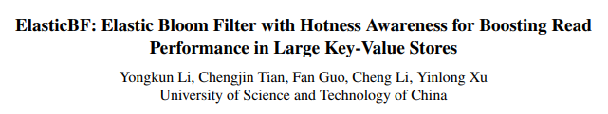
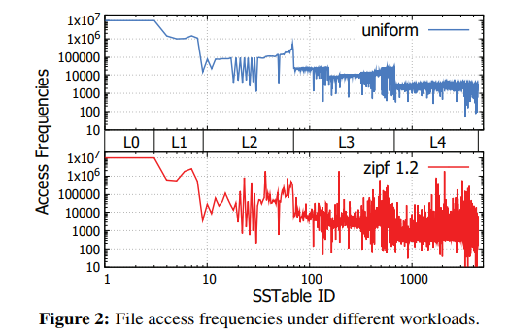
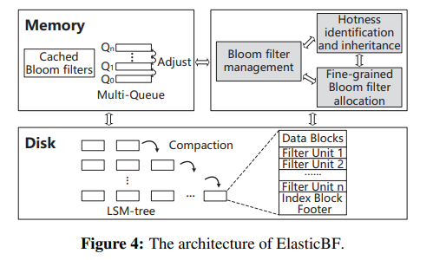
2. LSM-Tree Improvements
Auto-Tunning (Dynamic Bloom Filter Memory Allocation)
ElasticBF
Manage Bloom filter memory allocation
Dynamically adjusts the Bloom filter false positive rates
Based on data hotness and access frequency (Read performance)
Has multiple smaller Bloom filters

Slide 24
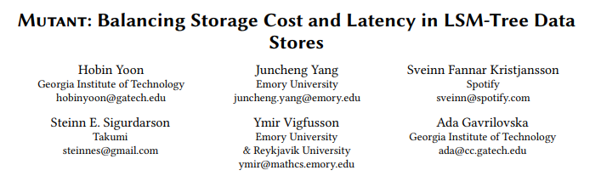
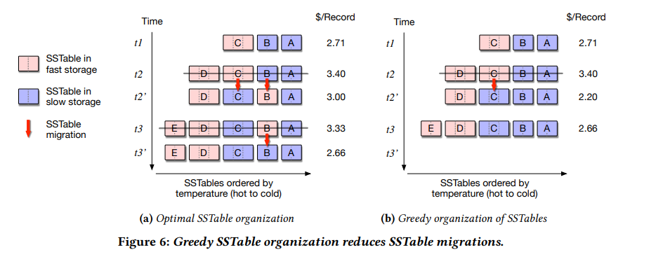
2. LSM-Tree Improvements
Auto-Tunning (Optimizing Data Placement)
Mutant
Optimizes the data placement on cloud storage
Monitoring the access frequency of each SSTable and finding a subset of SSTables to be placed in fast storage
Total number of accesses to fast storage is maximized

Slide 25
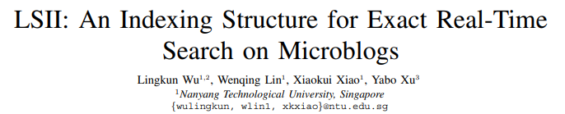
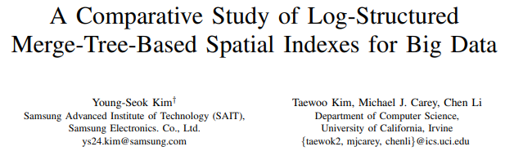



2. LSM-Tree Improvements
Secondary Indexing (Index Structures)
The Log-Structured Inverted Index (LSII)
Query q searches for the top K microblogs with the highest scores
Weighted sum of significance, freshness, and relevance
Kim et al
Spatial index structures for geo-tagged data
R-Tree: balanced search tree that stores multi-dimensional spatial data using their minimum bounding rectangles
Filters
Each component of the primary and secondary indexes with a filter to enable data pruning based on a filter key during query processing
Special care for filter while update and delete

Slide 26






2. LSM-Tree Improvements
Secondary Indexing (Index Maintenance)
Diff-Index (Hbase)
Four index maintenance: namely sync-full, sync-insert, async-simple, async-session
Update: insert new entry / cleaning old entry(problem, in point lookup)
Deferred Lightweight Indexing (DELI)
Enhances sync-insert update scheme of Diff-Index (scanning primary index)
Cannot support index-only queries efficiently
Luo and Carey
Batched lookup algorithm is the most effective optimization for reducing random I/Os
Maintain secondary indexes lazily in the background
Mutable bitmap strategy

Slide 27


2. LSM-Tree Improvements
Secondary Indexing (Statistics Collection)
Absalyamov et al
Proposed lightweight statistics collection framework
Integrate the task of statistics collection into the flush and merge operations to minimize the statistics maintenance overhead

Slide 28



2. LSM-Tree Improvements
Secondary Indexing (Distributed Indexing)
Joseph et al (Hbase)
Global secondary indexes / Local secondary indexes
Indexing data in parallel database
GCI: separate table that stores secondary keys plus their corresponding primary keys
Zhu et al (No paper)
Efficient approach for loading GSI: With Three Steps
Duan et al (No paper)
Lazy maintenance approach for materizlized views on distributed LSM-trees
Append new updates into a delta list of the materialized view to reduce the overhead during data ingestion

Slide 29

2. LSM-Tree Improvements

Slide 30









2. LSM-Tree Improvements

Slide 31

3. Conclusion
Conclusion
Advantages: superior write performance, high space utilization, immutability of on-disk data and tunability
Widely adopted and deployed to serve a variety of a workload
Useful guide to the state-of-the-art in LSM-based storage techniques for researchers, practitioners, and users

Slide 32
LSM-based Storage Techniques: A Survey
Chen Luo, Michael J. Carey
VLDB Journal, 2019
Thank you !
2021. 08. 30
Presentation by Shin, Hojin
hojin03s@dankook.ac.kr

